Slide 1
Game Design and Development
Space Shooter

Slide 2
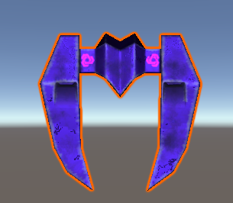
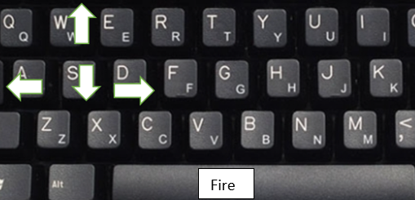
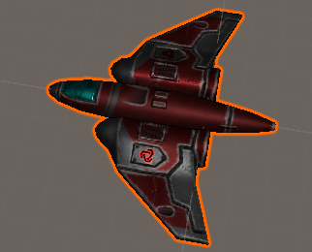
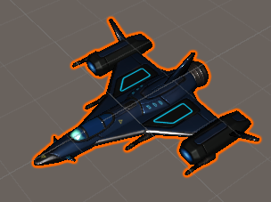
Game characters and navigations
Purple spaceship (health=6)- Stronger enemy
Controls- Up(W key), Down(S key), Right(D key), Left(A key), Shoot bullets(Spacebar)
Player Spaceship(health=100)- Controlled By Player
Red spaceship(health=3)- Weaker enemy
Notes:
Shooting game- Spaceship on rails
Enemies have different health levels
More dangerous enemy, more it health level, more the points upon hitting it
Spawning enemies as per health/score of player

Slide 3
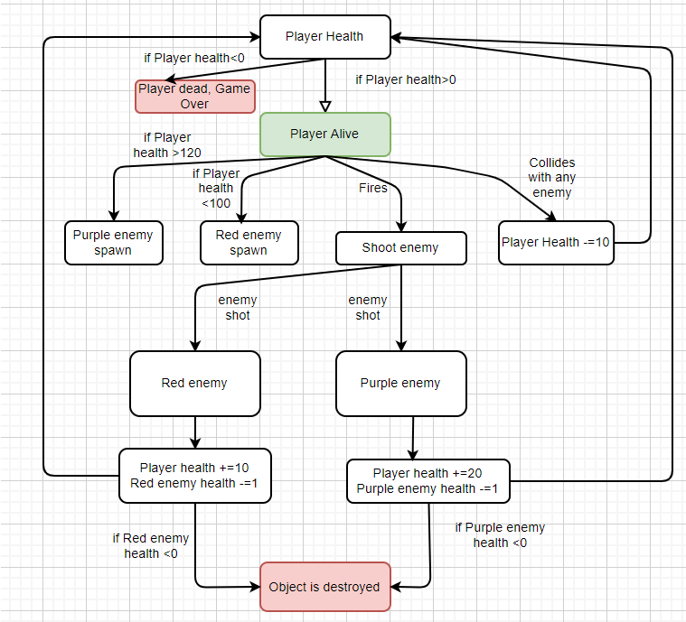
Flow and Difficulty concepts
Notes:
Shooting game- Spaceship on rails
Enemies have different health levels
More dangerous enemy, more it health level, more the points upon hitting it
Spawning enemies as per health/score of player
Explain DDA, few parameters, DDA monitirs health, what change will happen
Implementation of DDA
Threshhold approh to increase elvele. When paramters mnitored omthhings trihggered
Paramters-

Slide 4
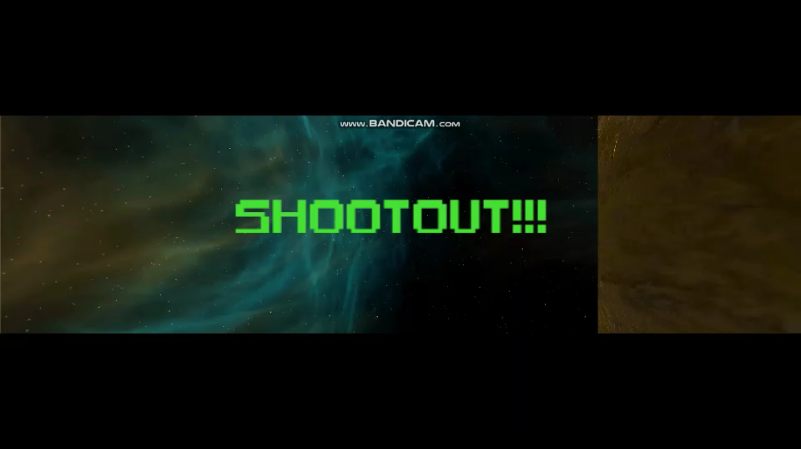
GamePlay Video below, and Play game here- https://simmer.io/@UniGameDev/space-shooter

Slide 5
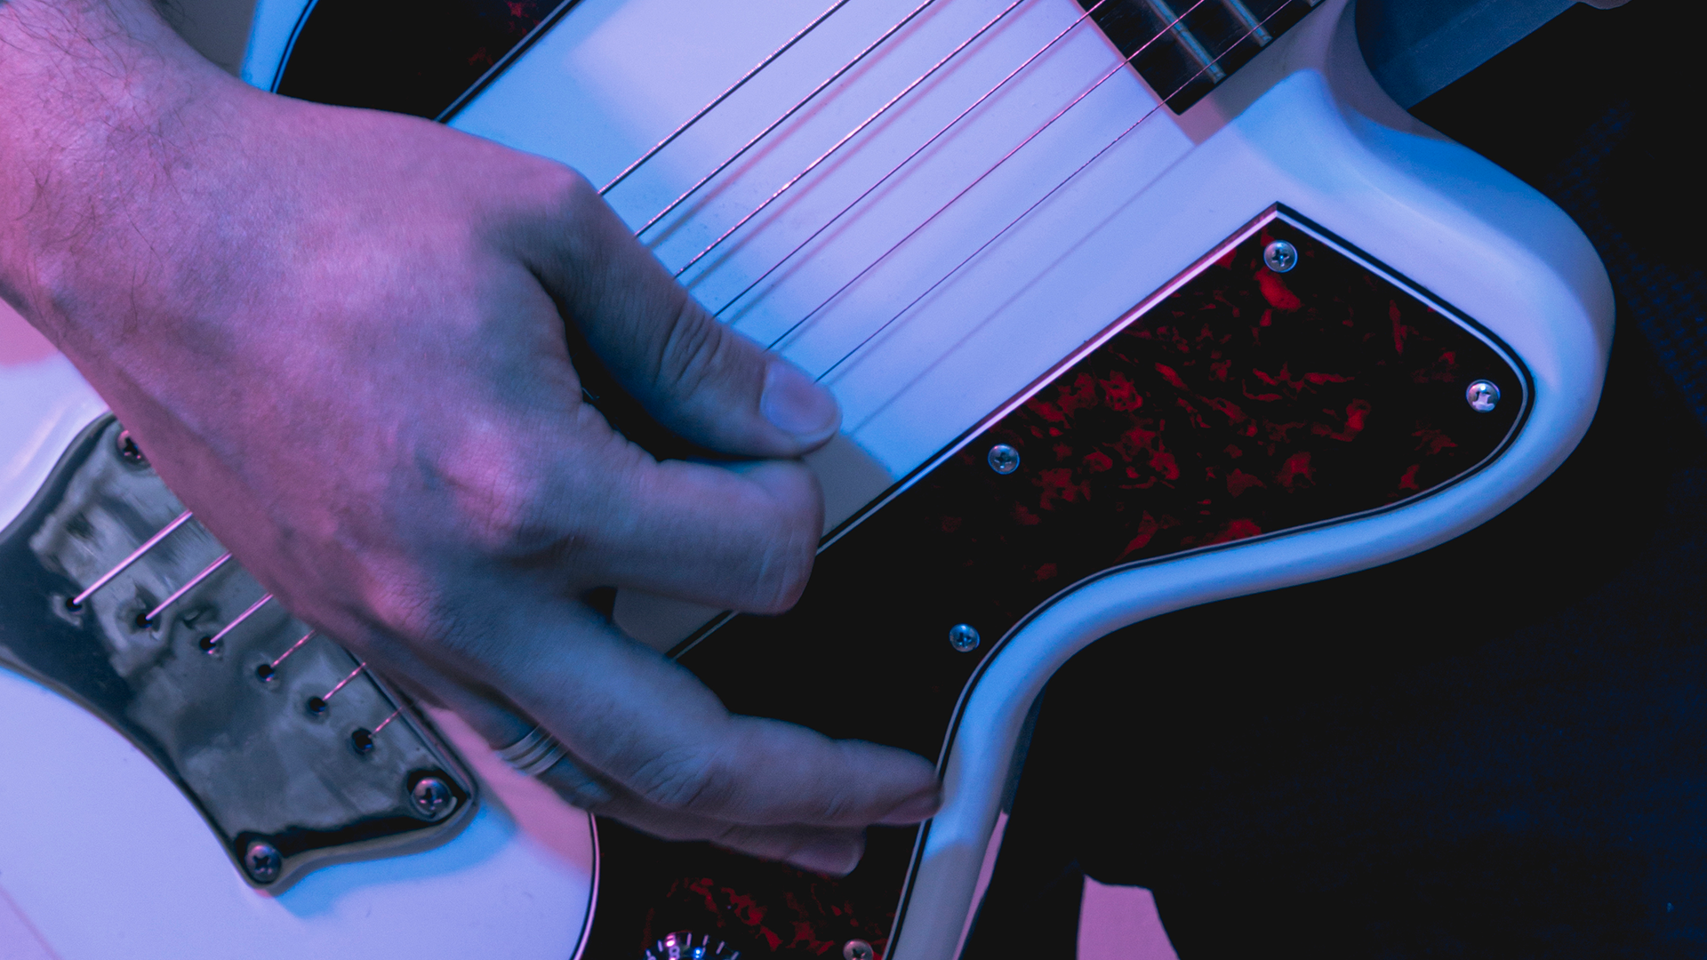
Thank You

